Slide 1

Why we need this system?

Slide 2
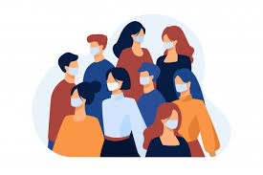
To identify vaccinated people
We have to identify vaccinated people among a large crowd.
If there is someone who is not vaccinated it is a huge risk for the other people.
ex: consider a shopping mall if a non vaccinated one came it is a huge risk.

Slide 3
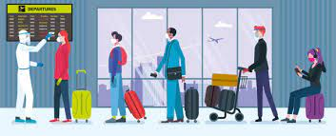
As a solution to a manual system
It is difficult to manage a manual system in this pandemic situation.
In public places it is not easy to continue with manual system as we don’t know who and where be a covid-19 patient.

Slide 4
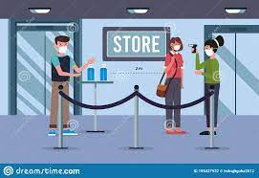
Reduce risk of spreading the virus
In manual checking system the vaccinated cards are exchanging between system.
Indeed that is a high risk of spreading the virus.

Slide 5
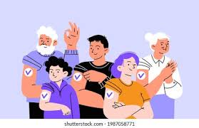
In Sri Lanka it is not still prohibited to go without vaccinating.
But in countries like USA, Italy it is prohibited to go out without vaccinating.
In that case this system will be needed to fight against the covid-19.

